Slide 1
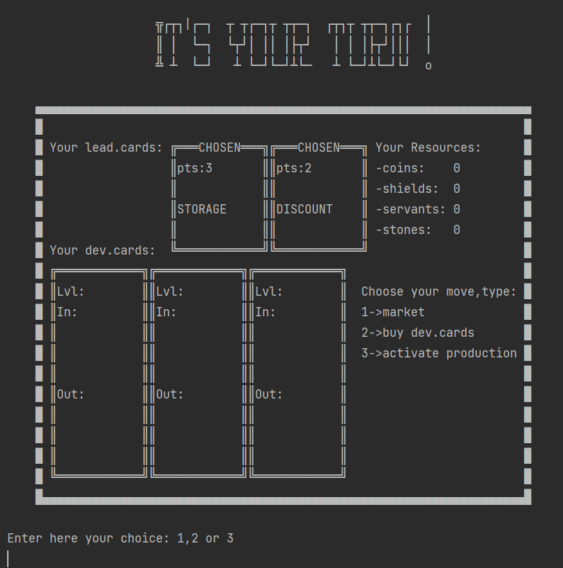
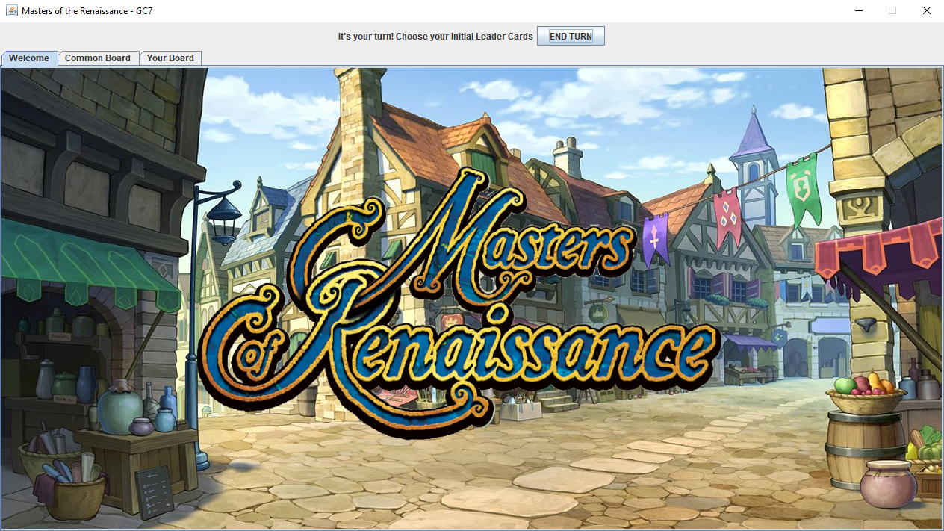
Prova finale di Ingegneria del Software
GC07
Francesco Panebianco
Vincenzo Pecorella
Elisa Mariani

Slide 2
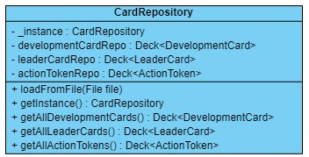
CORE decisions
- ASCII Art for Command Line Interface
- Swing over JavaFX
- Full Rule Set + 2 Advanced Features (Multiple Game Sessions, Disconnection Resilience)
- Thin Client
- Client-Server messages and Card Data use JSON serialization (GSON Library)

Slide 3
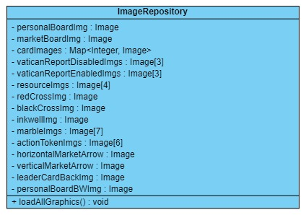
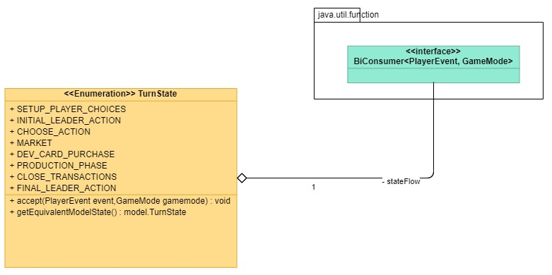
Other decisions
- On Client Side, graphics are loaded once to optimize memory usage and can easily be accessed through a ImageRepository (Singleton
- When the controller receives a PlayerEvent, the message is handled by a BiConsumer encapsulated in each state the player turn may be (TurnState). Each consumer function calls methods from GameMode, a controller class containing methods to perform actions on the game session.

Slide 4
A CRITICAL DECISION
We decided to implement the FA: Client Reconnection using a ping mechanism
Many reasons led us to this decision:
The clients’ connection isn’t reliable: in some cases they disconnect without notify the server
Since the disconnected players skip their turn, by a tactical prospective can be useful to always know who’s connected and who’s not
A simple idea to know when a client is disconnected is to put a timer on player’s moves: it’s easy to implement but
Puts a constraint on users’ move time
To recognise that a player is truly disconnected a long timeout must pass and all the players have to wait

Slide 5
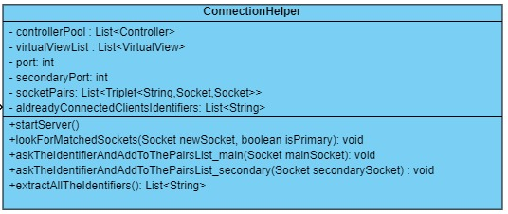
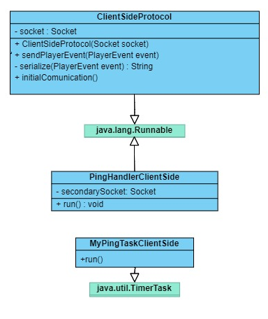
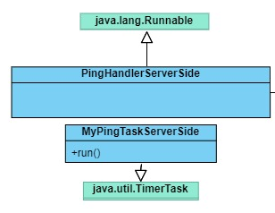
A CRITICAL DECISION
- We then chose to implement a ping mechanism. Handling disconnections properly, especially in the CLI, ended up requiring two sockets: one for the CompressedModel / PlayerEvent messages and one for the continuous ping message. With the current implementation, it takes 5 seconds without a ping to disconnect the player.
- To pair the two sockets without ambiguity, a unique identifier for the client is generated randomly and sent upon first connection.
- Thanks to this approach, the thread that receives the message also handles the turn and sends the answer back. This eliminates many syncronization hazards.

Slide 6
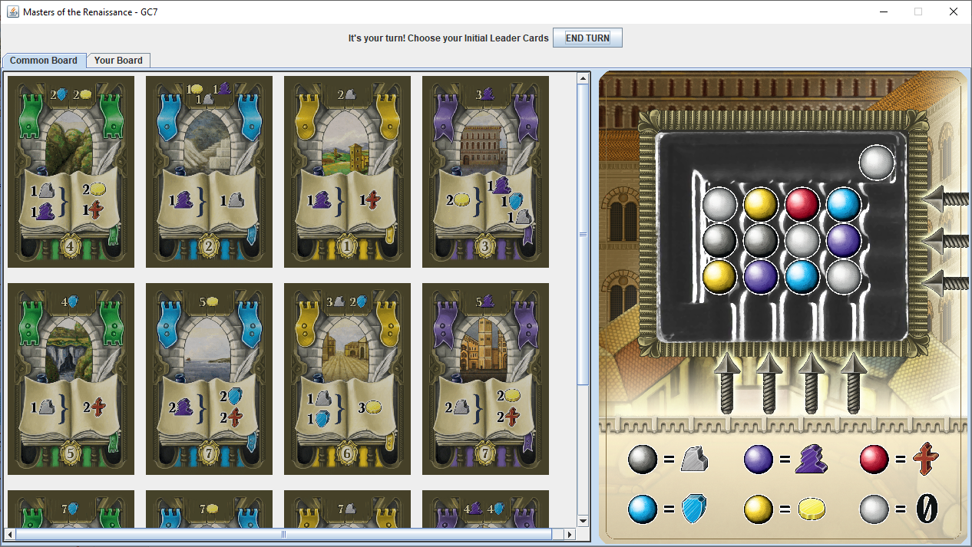
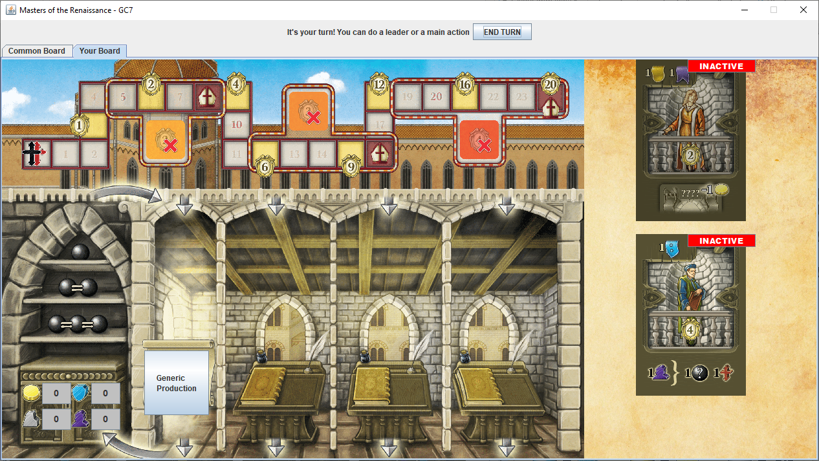
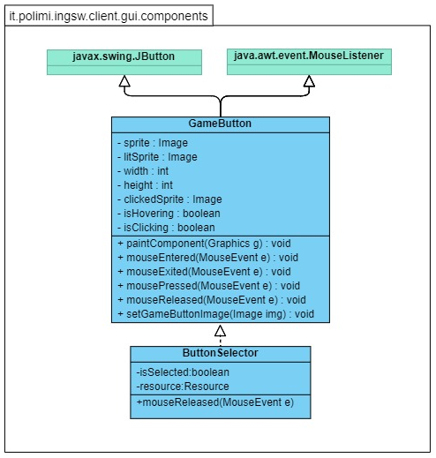
CLI & GUI
Common Board
Contains common spaces available to all players: Market Board and Development Card Grid.
Player Board
Contains the player specific buttons and views.
Buttons are disabled for other players’ boards.
Other players’ leader cards become visible upon activation
- Selection of cards and market rows / columns is done with GameButtons, which have transparent backgrounds and are highlighted when the mouse hovers on them.

Slide 7
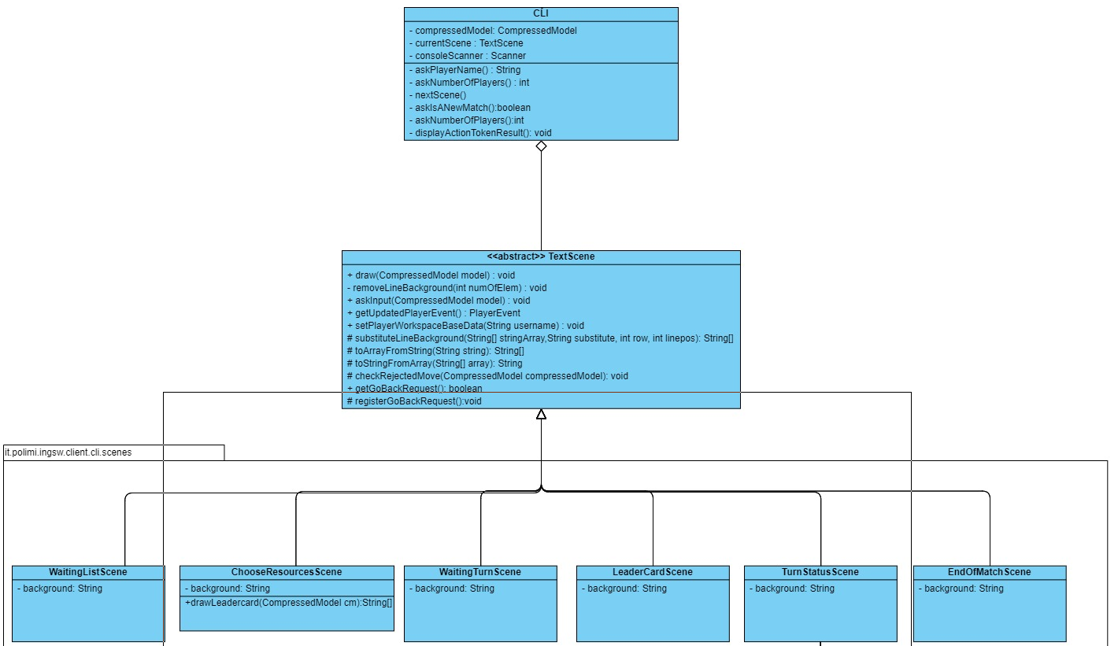
CLI & GUI
- Values are inserted by overwriting parts of an ASCII background using a buffer string. The final string is then printed. Methods to insert said values are contained in the abstract TextScene class, from which every actual scene inherits.
The TextScene class has two main methods:
Draw() : it prints all the information that the player needs to see in the current scene
AskInput(): retrieves the input from the player
- The correct scene is shown based on the TurnState received from server.

Slide 8
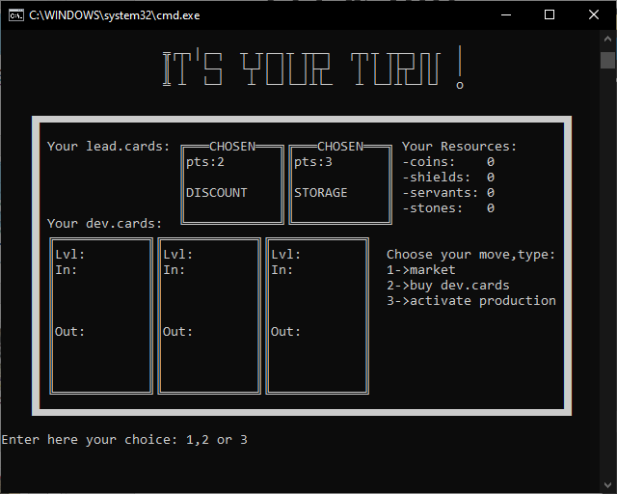
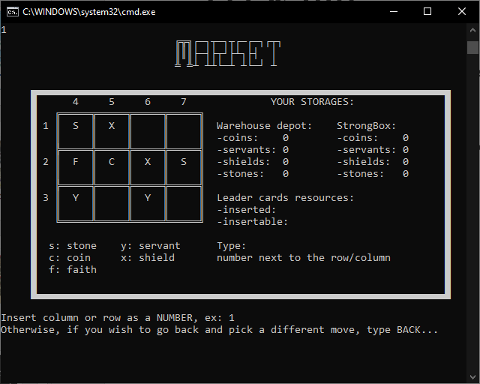
CLI & GUI
CLI - TurnStatusScene
Here the players can see their Development cards and owned resources.
- They are given the choice to do a Market Action, Buy a Dev Card or Activate Production Powers

